Slide 1
Week 9’s Work Progress
By: Abdur Rehman

Slide 2
Results 1:
tuner.results_summary()
Best mean_squared_error So Far: 0.0003077887726249173
Total elapsed time: 00h 40m 25s
best_hp.values
{'input_delay_size': 17, 'activation_': 'sigmoid', 'hidden_layers': 5, 'units_nodes_0': 72, 'units_nodes_1': 224, 'learning_rate': 0.01, 'units_nodes_2': 160, 'units_nodes_3': 192, 'units_nodes_4': 136, 'units_nodes_5': 112, 'units_nodes_6': 192, 'units_nodes_7': 64, 'shuffle': True, 'units_nodes_8': 72, 'units_nodes_9': 96, 'units_nodes_10': 192, 'units_nodes_11': 80, 'units_nodes_12': 160, 'units_nodes_13': 216, 'units_nodes_14': 56, 'units_nodes_15': 176, 'units_nodes_16': 184, 'units_nodes_17': 208, 'units_nodes_18': 56, 'units_nodes_19': 240}
History TEST
loss | 0.0005709582474082708
mean_absolute_error | 0.015417874790728092
mean_squared_error | 0.0005709582474082708
root_mean_squared_error | 0.02389473095536232
History TRAIN
loss | 0.00013503145601134747
mean_absolute_error | 0.0062272148206830025
mean_squared_error | 0.00013503145601134747
root_mean_squared_error | 0.011620303615927696

Slide 3
Model: "sequential_1"
_________________________________________________________________
Layer (type) Output Shape Param #
=================================================================
flatten_1 (Flatten) (None, 102) 0
dense_20 (Dense) (None, 72) 7416
dense_21 (Dense) (None, 224) 16352
dense_22 (Dense) (None, 160) 36000
dense_23 (Dense) (None, 192) 30912
dense_24 (Dense) (None, 136) 26248
dense_25 (Dense) (None, 4) 548
=================================================================
Total params: 117,476
Trainable params: 117,476

Slide 4
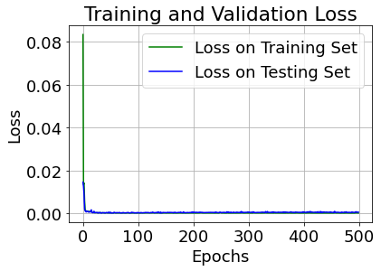
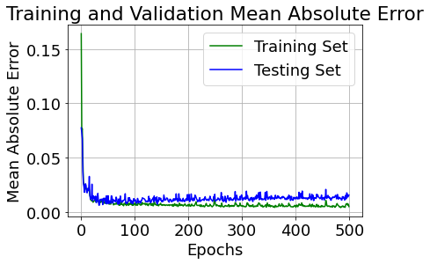

Slide 5
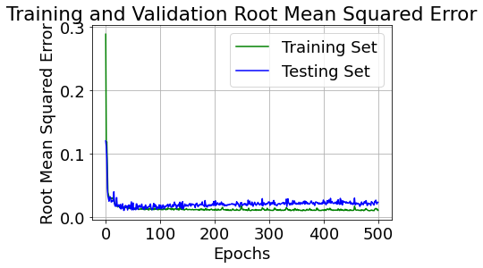

Slide 6
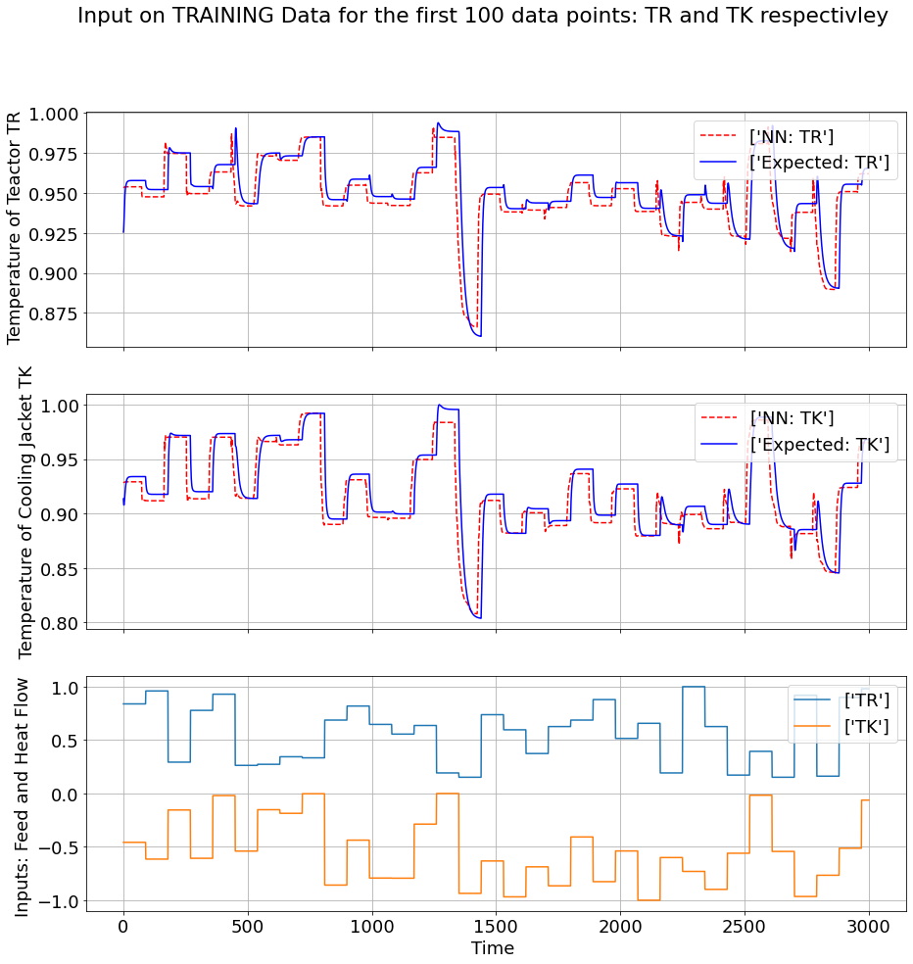

Slide 7
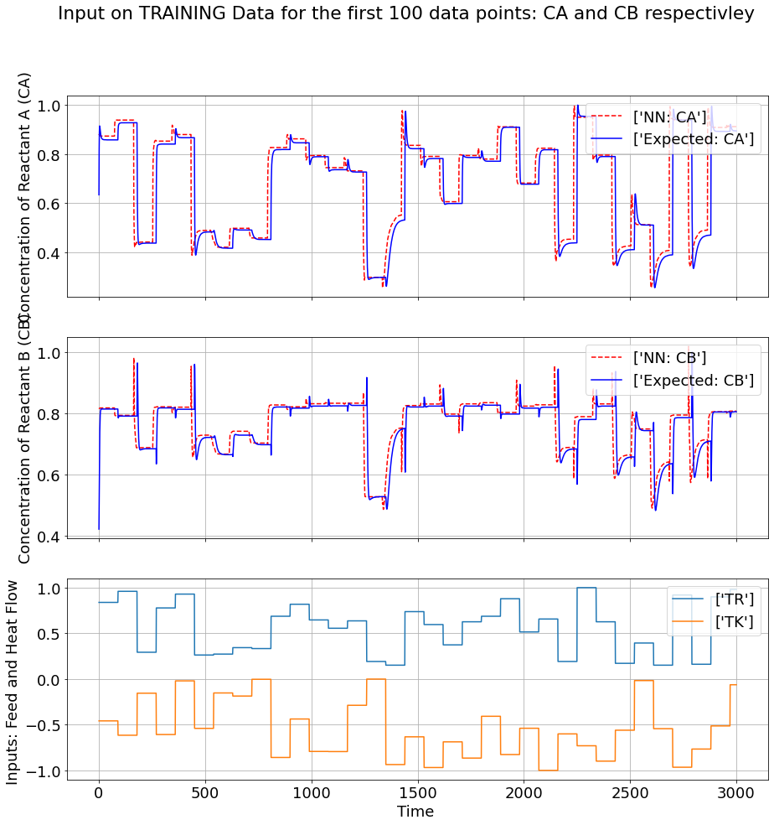

Slide 8
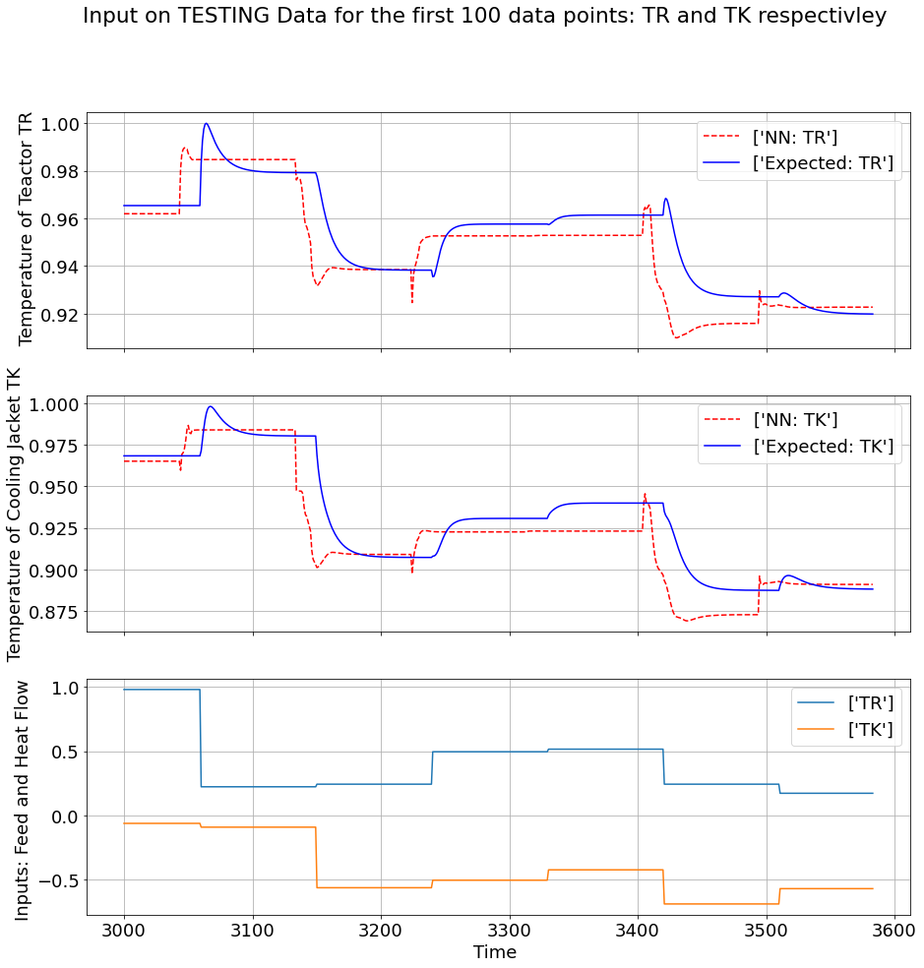

Slide 9
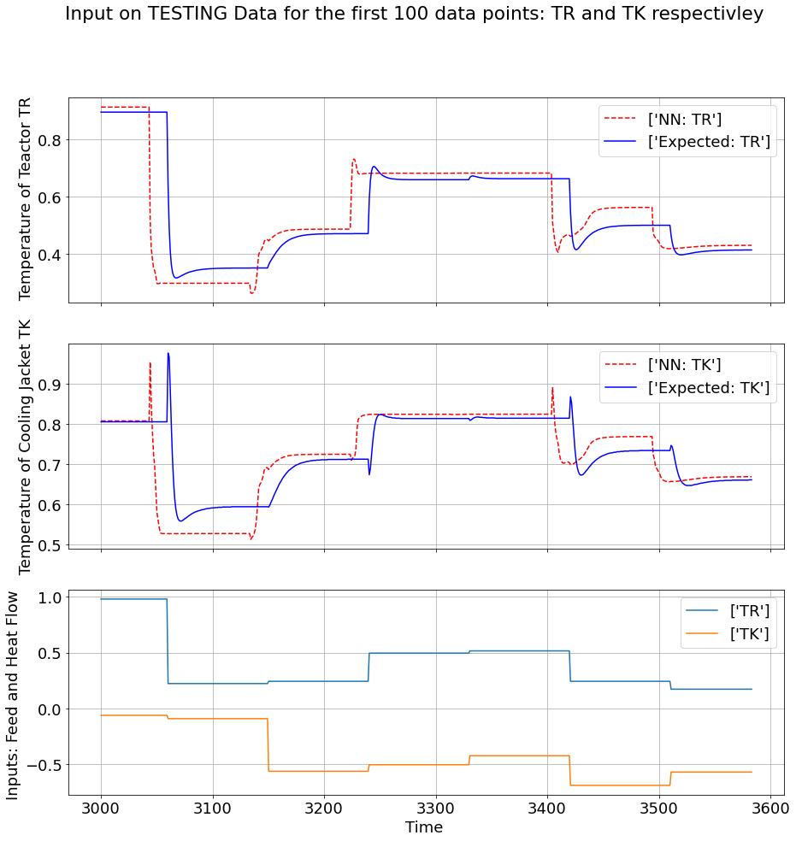

Slide 10
CLOSED LOOP SIMULATION

Slide 11
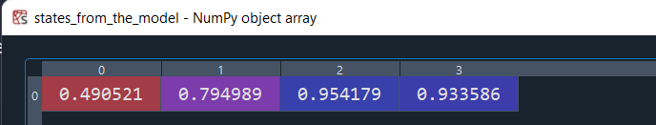
STEP I: Creation of a Dummy Array to feed the Input and run the Closed Loop Simulation
Step II: Setting up the initail Valuse for the closed loop simulation from the inputs[0] to dummy variable [0]
STEP III: Take the entire row and feed it to the Neural Network (X_K)
STEP IV: Shifting all of the STATES based on the delay (X_K-1)

Slide 12
STEP V: Shifting all of the Inputs based on the delay (U_k-1)
STEP VI: Transferring the Neural Network States to the Closed Loop Simulating Array
STEP VII: Importing the Inputs to the Closed Loop Simulation (U_k)
STEP VIII: REPEAT THE PROCESS FOR ALL ROWS

Slide 13
Starting Time:
Closed Loop Simulation Started
Build finished in closed_loop 2 minutes 34 seconds
Build finished in closed_loop 94.4696 seconds
Closed Loop Simulation Ended

